Slide 1
«GREAT BRITAIN»

Slide 2
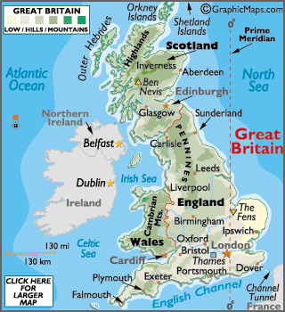
GEOGRAPHY
Great Britain consists of England, Scotland and Wales. It’s an island. It’s situated in the west of Europe. It’s washed by the Atlantic Ocean and the North Sea. There are a lot of rivers and lakes, valleys and forests, rocks and hills. Its landscape is very picturesque. The weather is usually wet and foggy. Great Britain has borders with France, Ireland and other European countries.

Slide 3
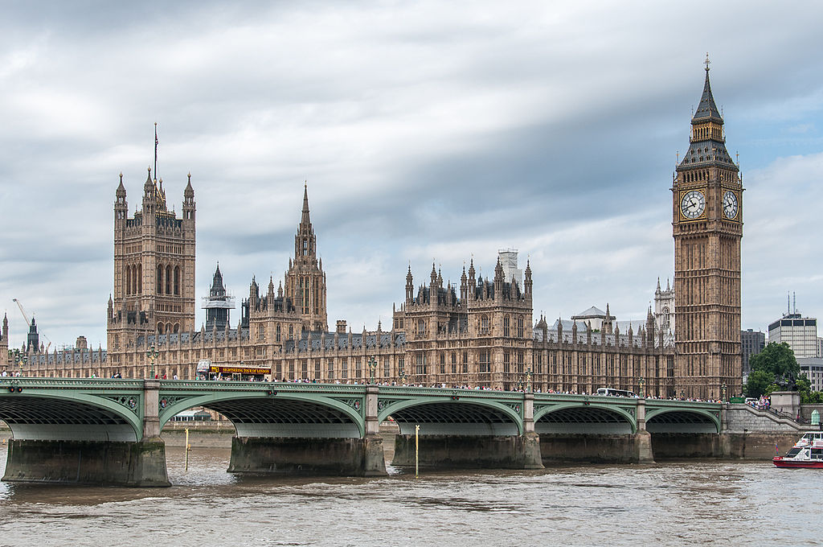
London
The capital of the UK is London.

Slide 4

Scotland
Scotland is the part of the United Kingdom. Scotland has a population of just over 5 million people of whom one third live in the cities of Edinburgh, Glasgow, Aberdeen and Dundee.

Slide 5
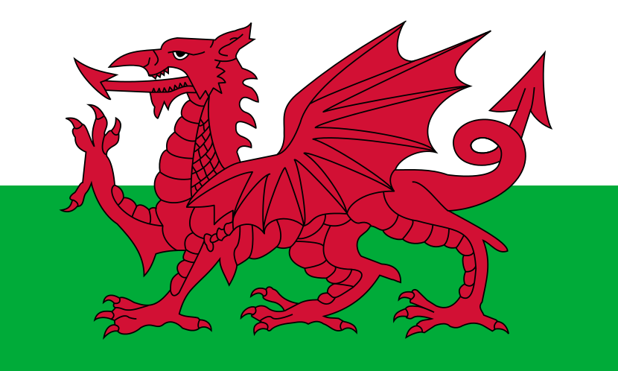
Wales
Wales is a small country, bounded on the north and west by the Irish Sea, and on the south by the Bristol Channel. About two thirds of the population live in the South Wales coastal area, where the three biggest towns are located: Swansea, Cardiff and Newport. Cardiff is the capital of Wales.

Slide 6
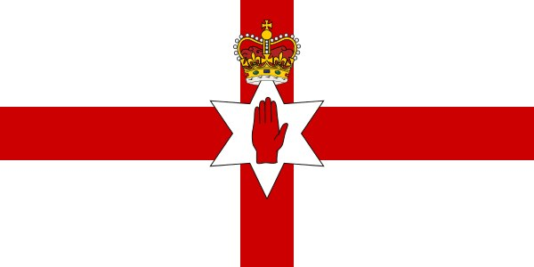
Northern Ireland
Northern Ireland is the second largest of the British Islands lying in the Atlantic off the west coast of Great Britain. The island of Ireland is politically divided into two parts: Northern Ireland (Ulster), which forms part of the united Kingdom of Great Britain, capital Belfast, and the Republic of Ireland – a separate state named Eire in Irish; its capital is Dublin.

Slide 7


SYMBOLS
The flag of Great Britain is red, white and blue. The British people call it “the Union Jack”
The coat of arms of Great Britain has a crown on the shield, because it’s a monarchy. The shield is supported by the English lion and by the Unicorn of Scotland.

Slide 8
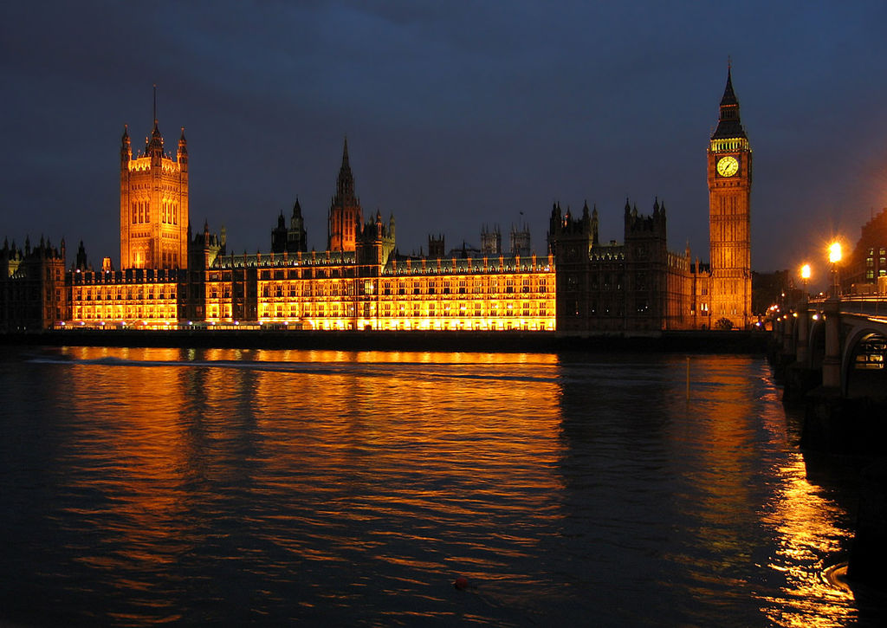
BRITAINS GOVERNMENT
The UK is a constitutional monarchy, the Head of State is the Queen. The British Parliament consists of two Chambers: the House of Lords and the House of Commons.

Slide 9
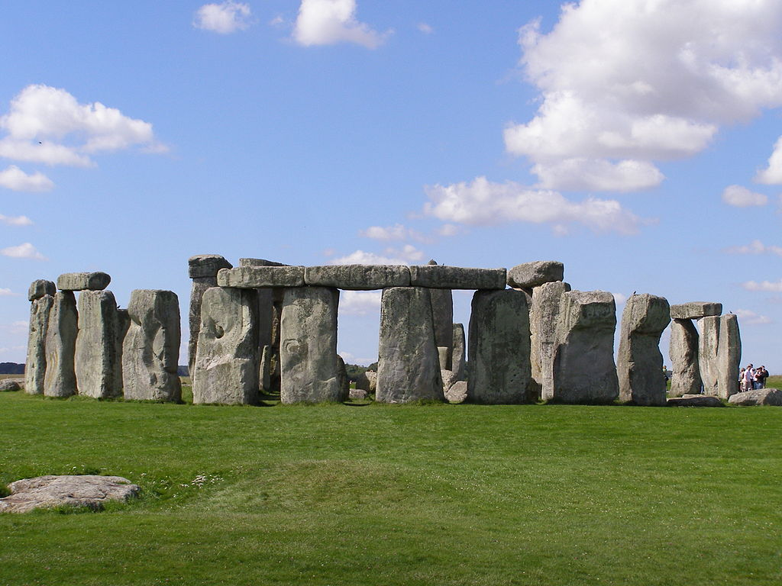
Stonehenge
Stonehenge is a prehistoric monument located in Wiltshire

Slide 10
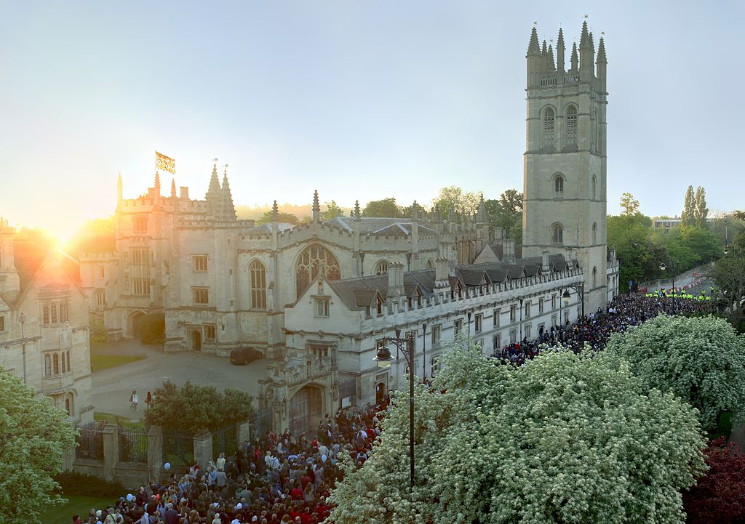
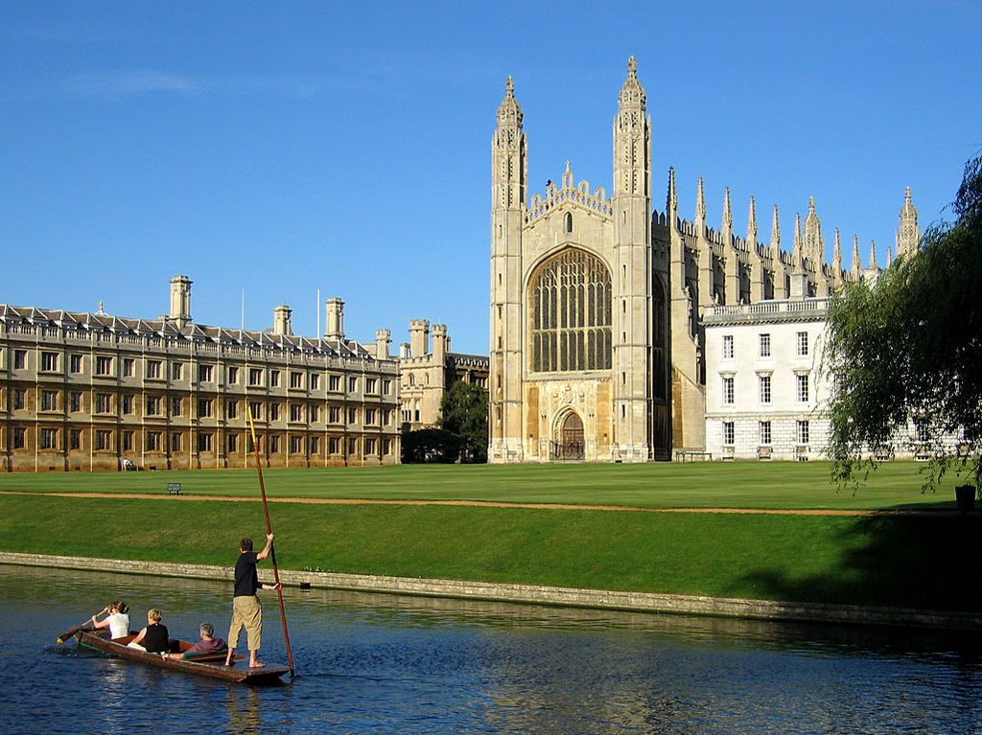
Oxford and Cambridge
Oxford is the home of the oldest university of England. Cambridge is the home of Britain's second oldest university.

Slide 11
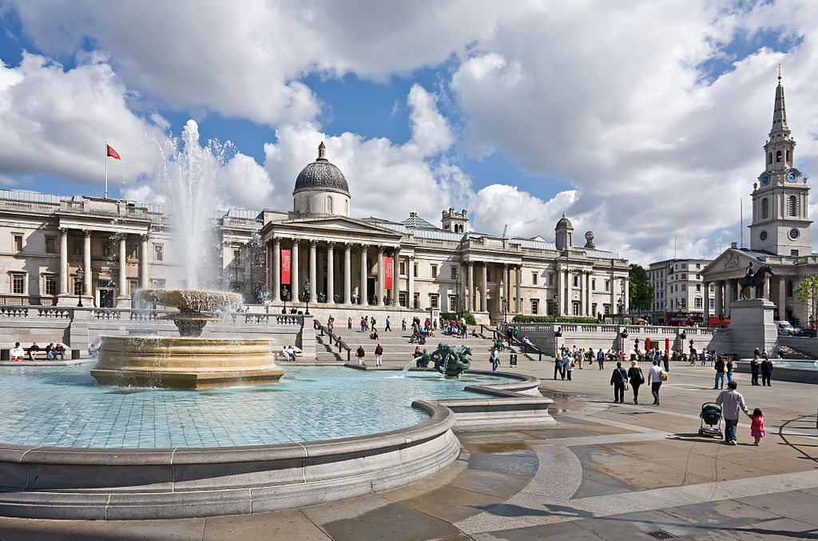
Trafalgar Square
Trafalgar Square is a public space and tourist attraction in central London.

Slide 12
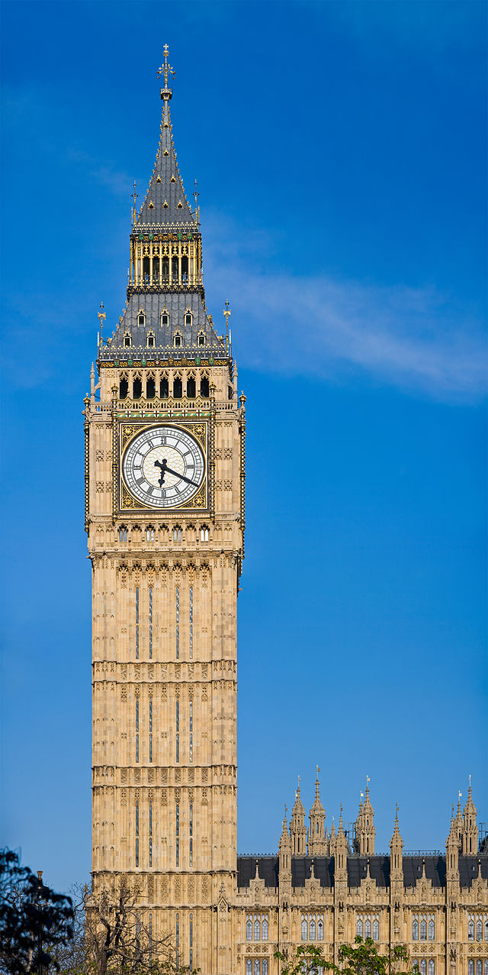
Big Ben
Big Ben is the nickname for the Great Bell of the clock at the north end of the Palace of Westminster in London, and often extended to refer to the clock and the clock tower.

Slide 13
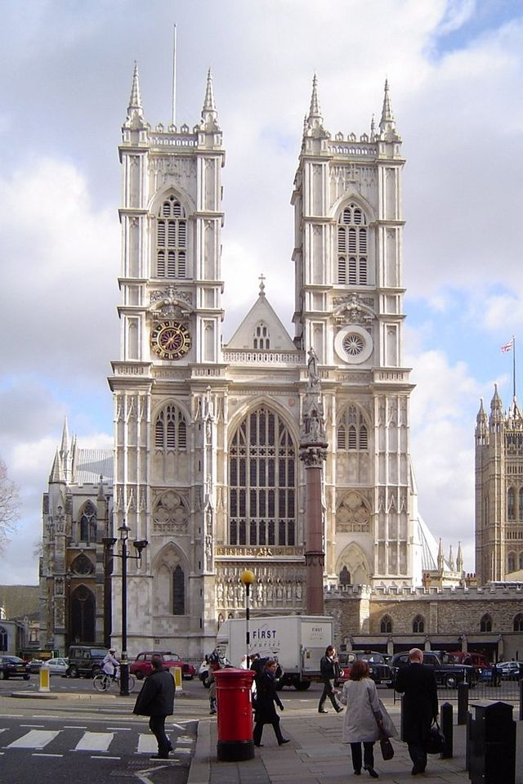
Westminster Abbey

