Slide 1
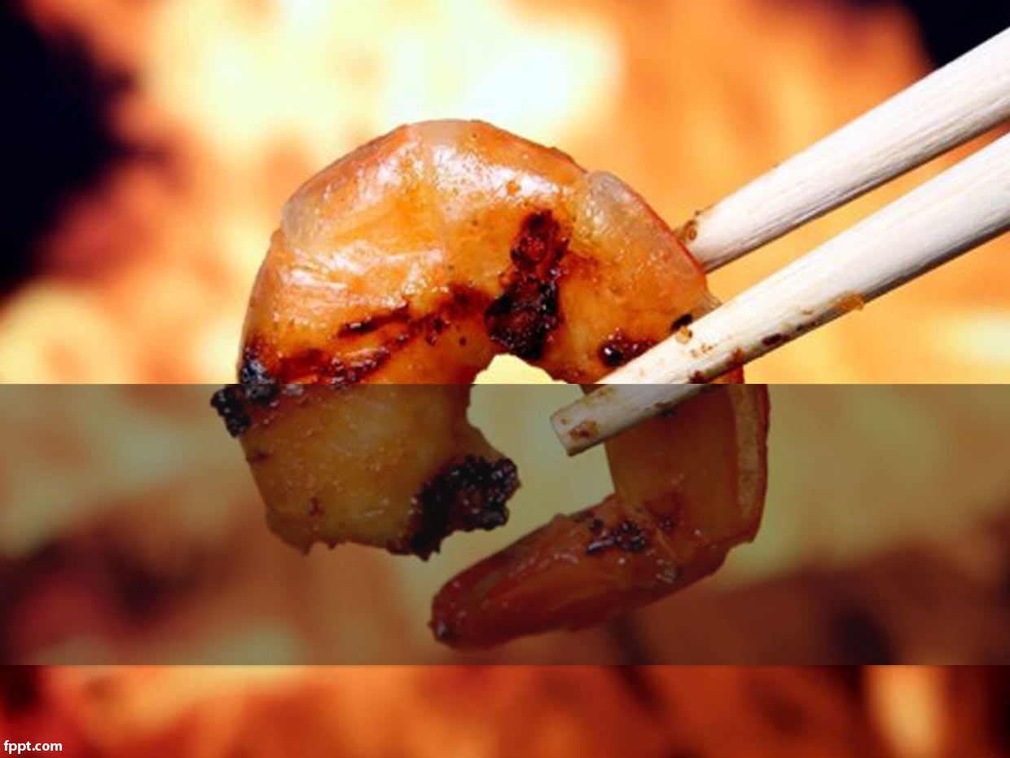
SEAFOOD

Slide 2
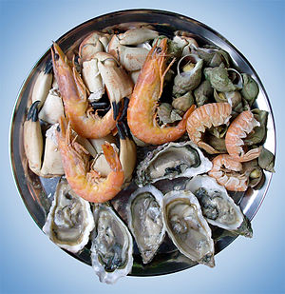
SEAFOOD
Seafood is any form of sea life regarded as food by humans. Seafood prominently includes fish and shellfish.

Slide 3
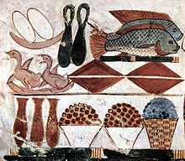
HISTORY OF EATING SEAFOOD
Findings in South Africa indicate Homo sapiens (modern humans) harvested marine life as early as 165,000 years ago.
The ancient river Nile was full of fish; fresh and dried fish were a staple food for much of the population.
Various foods depicted in an Egyptian burial chamber, including fish, c. 1400 BC

Slide 4
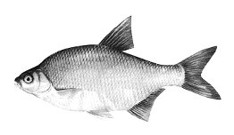
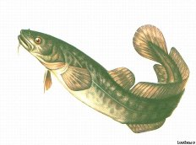
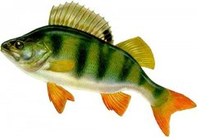
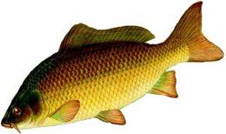
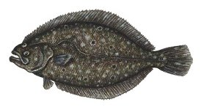
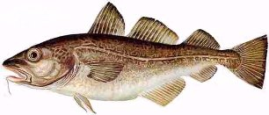
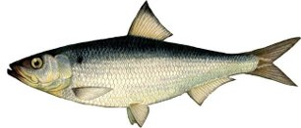
BREAM
BURBOT
BASS
CARP
FLOUNDER
COD
HERRING

Slide 5
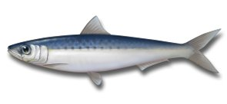
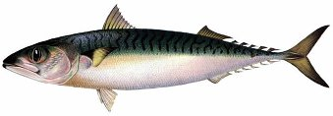
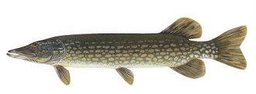
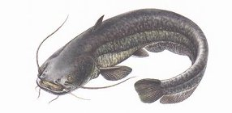
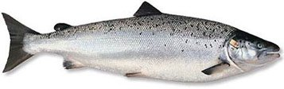
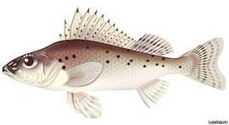
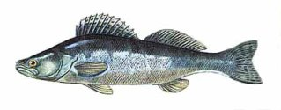
SARDINE
MACKEREL
PIKE
SHEATFISH
SALMON
PIKE-PERCH
RUFF

Slide 6
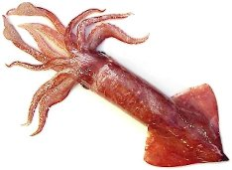
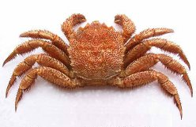
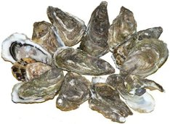
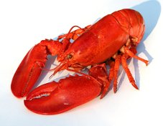
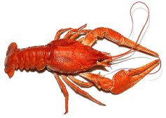
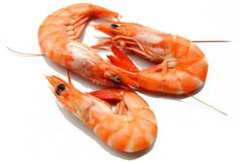
SQUID
CRAB
OYSTERS
CRAYFISH
LOBSTER
SHRIMP

Slide 7
HEALTH BENEFITS
Fish is high in minerals such as zinc, iodine and selenium.
Adding one portion of fish a week to your diet can cut your chances of suffering a heart attack by half.
Omega-3 fats also have natural anti-oxidants.
Regularly eating fish oils is also thought to reduce the risk of arrhythmia.

Slide 8
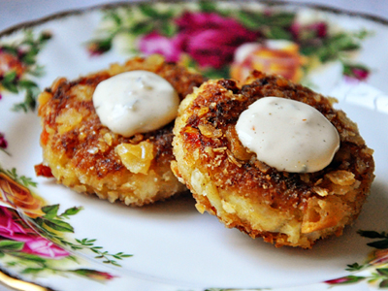
CRAB CAKES

Slide 9
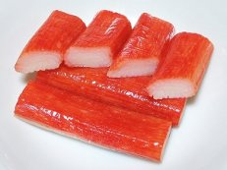
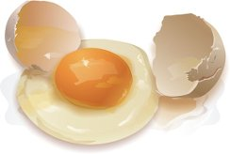
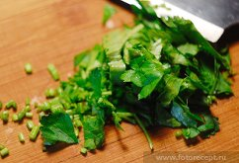
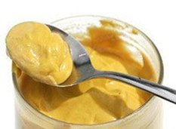
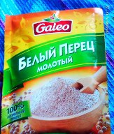
INGREDIENTS
450 g pack crab meat
1 whole egg, beaten
1 tbsp chopped parsley
1 ½ tsp mustard
¼ tsp ground white pepper

Slide 10
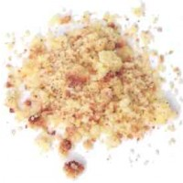
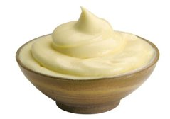
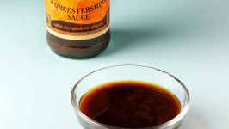
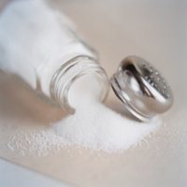
INGREDIENTS
½ cup breadcrumbs
½ cup mayonnaise
2 tsp Worcestershire sauce
1 tsp salt

Slide 11

CRAB CAKES/DIRECTIONS
1. Mix all ingredients except crab meat. Add crab and toss lightly. Chill for at least 1 hour, put into a frying pan and dust with flour.
2. Sauté in clarified butter over medium heat until golden brown on each side. Serve hot.

Slide 12
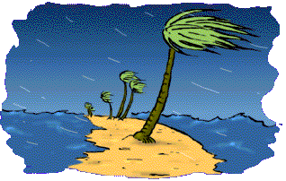
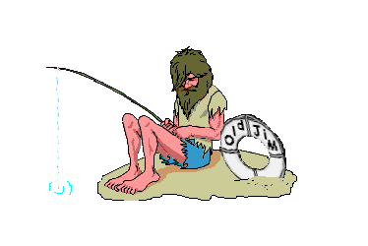


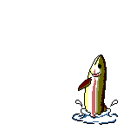
BON APPETIT!

